Slide 1
ISO27001:2013 Controls Appendix; Part 7
In this module lets look at ISO27001:2013 (ISMS) related to operations security…

Slide 2
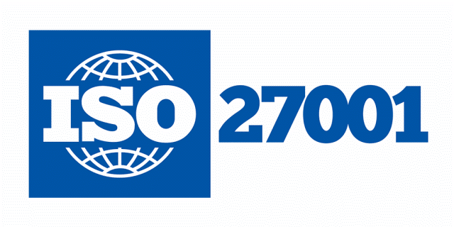
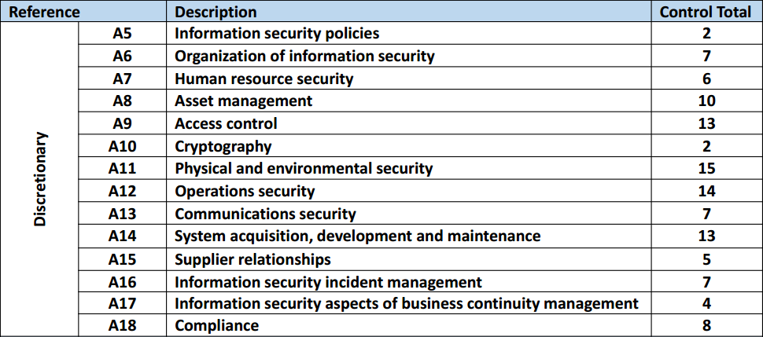
ISO27001:2013 Controls Appendix; Part 7
ISO27001:2013 DISCRETIONARY CONTROLS
TOTAL: 114
https://chapters.theiia.org/bermuda/Events/ChapterDocuments/Information%20Security%20Management%20System%20%28ISMS%29%20Overview.pdf

Slide 3
ISO27001:2013 Controls Appendix; Part 7
A.12 OPERATIONS SECURITY
A.12.2 PROTECTION FROM MALWARE
A.12.2.1 | CONTROLS AGAINST MALWARE
A.12.2.1 | CONTROLS AGAINST MALWARE | Control: Detection, prevention and recovery controls to protect against malware shall be implemented, combined with appropriate user awareness.

Slide 4
ISO27001:2013 Controls Appendix; Part 7
A.12 OPERATIONS SECURITY
A.12.3 BACKUP
A.12.3.1 | INFORMATION BACKUP
A.12.3.1 | INFORMATION BACKUP | Control: Backup copies of information, software and system images shall be taken and tested regularly in accordance with an agreed backup policy.

Slide 5
ISO27001:2013 Controls Appendix; Part 7
A.12 OPERATIONS SECURITY
A.12.4 LOGGING & MONITORING
A.12.4.1 | EVENT LOGGING
A.12.4.2 | PROTECTION OF LOG INFORMATION
A.12.4.3 | ADMINISTRATOR & OPERATOR LOGS
A.12.4.4 | CLOCK SYNCHRONISATION

Slide 6
ISO27001:2013 Controls Appendix; Part 7
A.12 OPERATIONS SECURITY
A.12.4.1 | EVENT LOGGING | Control: Event logs recording user activities, exceptions, faults and information security events shall be produced, kept and regularly reviewed.

Slide 7
ISO27001:2013 Controls Appendix; Part 7
A.12 OPERATIONS SECURITY
A.12.4.3 | ADMINISTRATOR & OPERATOR LOGS | Control: System administrator and system operator activities shall be logged and the logs protected and regularly reviewed.

Slide 8
ISO27001:2013 Controls Appendix; Part 7
A.12 OPERATIONS SECURITY
A.12.5 CONTROL OF OPERATIONAL SOFTWARE
A.12.5.1 | INSTALLATION OF SOFTWARE ON OPERATIONAL SYSTEMS
A.12.5.1 | INSTALLATION OF SOFTWARE ON OPERATIONAL SYSTEMS | Control: Procedures shall be implemented to control the installation of software on operational systems.

Slide 9
ISO27001:2013 Controls Appendix; Part 7
A.12 OPERATIONS SECURITY
A.12.6 TECHNICAL VULNERABILITY MANAGEMENT
A.12.6.1 | MANAGEMENT OF TECHNICAL VULNERABILITIES
A.12.6.2 | RESTRICTIONS ON SOFTWARE INSTALLATION

Slide 10
ISO27001:2013 Controls Appendix; Part 7
A.12 OPERATIONS SECURITY
A.12.6.1 | MANAGEMENT OF TECHNICAL VULNERABILITIES | Control: Information about technical vulnerabilities of information systems being used shall be obtained in a timely fashion, the organization’s exposure to such vulnerabilities evaluated and appropriate measures taken to address the associated risk.

Slide 11
ISO27001:2013 Controls Appendix; Part 7
A.12 OPERATIONS SECURITY
A.12.6.2 | RESTRICTIONS ON SOFTWARE INSTALLATION | Control: Rules governing the installation of software by users shall be established and implemented.

Slide 12
ISO27001:2013 Controls Appendix; Part 7
A.12 OPERATIONS SECURITY
A.12.7 INFORMATION SYSTEMS AUDIT CONSIDERATIONS
A.12.7.1 | INFORMATION SYSTEMS AUDIT CONTROLS

Slide 13
ISO27001:2013 Controls Appendix; Part 7
A.12 OPERATIONS SECURITY
A.12.7.1 | INFORMATION SYSTEMS AUDIT CONTROLS | Control: Audit requirements and activities involving verification of operational systems shall be carefully planned and agreed to minimise disruptions to business processes.

Slide 14
ISO27001:2013 Controls Appendix; Part 7
Lets look at communications security in the next module…
END

